Slide 1
Feature-Model
Feature
1
*
Requires
requirer
name: String
description: Text
binding-state: 3V-Boolean
optional: Boolean
1
*
requiree
1..*
2
*
Excludes
feature
involved
1..*
variant
parent
1
1
child
1
variation-point
refined-to
*
0..1
refined-from
0..1
0..1
Refinement
VP-Variant-Constraint
*
relation
Relation
Constraint
XOR
OR
state: 3V-Boolean
OCL Constraints:
context fm: Feature-Model
inv: fm.feature->select(refined-from->empty())->size = 1
context f: Feature
inv: f.refined-from->empty()
implies (not f.optional and f.binding-state)
context r: Refinement
inv: r.child.binding-state implies r.parent.binding-state
inv: not r.child.optional implies
(r.parent.binding-state implies r.child.binding-state)
context c: Requires
inv: c.state = (c.requirer.binding-state
implies c.requiree.binding-state)
context c: Excludes
inv: c.state = (c.involved->exists(binding-state <> true))
context c: VP-Variant-Constraint
inv: c.variant = c.variation-point.refined-to.child->asSet()
context c: OR
inv: c.state = (c.variation-point.binding-state
implies c.variant->exists(binding-state))
context c: XOR
inv: c.state = (c.variation-point.binding-state
implies c.variant->select(binding-state)->size = 1
①
②
③
④
⑤
⑥
⑦
⑧
⑨

Slide 2
Mobile-Phone Service
Calling Service
Internet Access
Route Navigation
Content Display
Multi-Media
Message Service
Ringing Alert
Call Answer
Call Out
Online Update
Display Quality
Music
Picture
Video
Msg Receive
Msg Send
Ringtone Customize
Low Resolution
Medium Resolution
High Resolution
Msg Notify
Delivery Confirm
Legend
Optional Feature
Refinement
Requires
XOR
Ringtone Download
Mandatory Feature
Excludes
OR
Sounding
vibrating
Continual Notifying
of Unread Msg

Slide 3
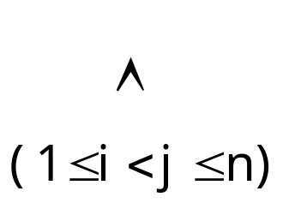
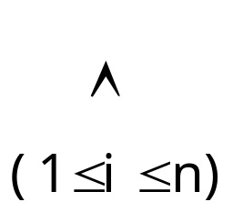
<<Root>>
R
A
B
A
B
A
B
P
(¬Ci∨P)
(¬Ci∨¬Cj)
C1
C2
Cn
P
A
A
P
C
B
C
B
C
C1
C2
Cn

